Slide 1

Empowering Fitness with Smart Gym
Tejas Patil - 22107024
Ganesh Patil - 22107045
Devesh Patil - 22107038
Siddesh Patil - 22107031
Project Guide:
Prof. Vaibhav Yavalkar

Slide 2
Contents
Introduction
Objectives
Scope
Features
Project Outcomes
Technology Stack
Block Diagram

Slide 3
1. Introduction
Smart Gym System simplifies operations, and enhances member experiences and day-to-day tasks for gym administrators and staff.
Problem Identified :
1. Difficulty in following proper nutrition
2. Not able to identify an appropriate workout plan for each day.
Solution Proposed :
1. Meal Planning: Developing a structured meal plan that aligns with dietary goals requires effort and organization.
2. Personalized Fitness Plans i.e Beginners, Intermediate, Advanced

Slide 4
2. Objectives
Provide a platform with an interactive user interface for both users and admin.
Get an online membership plan in an effective manner.
Get benefits by viewing different exercises and diet plans.
4. To encourage interest in diet, exercise, and health.

Slide 5
3. Scope
Customers can avail the diet plan of their own choice.
2. To develop attention in health, fitness and nutrition.
3. It will help to avoid manual data entries.

Slide 6
4. Features
1. Display personalized workout plans.
2. Offers a diverse range of exercises and workouts.
3. Display nutrition tracking and customized meal planning.
4. Personalize training and schedule to ensure prime fitness.
5. Renewal of membership plans.

Slide 7
5. Project Outcomes
1. Gym management software saves time and money for gym owners by automating many of the administrative processes involved in running a gym.
2. The gym member experience is enhanced, as membership registration is made easier.

Slide 8
6. Technology Stack
Jdk - 20
NetBeans IDE - 19
MySQL - 8.0.34

Slide 9
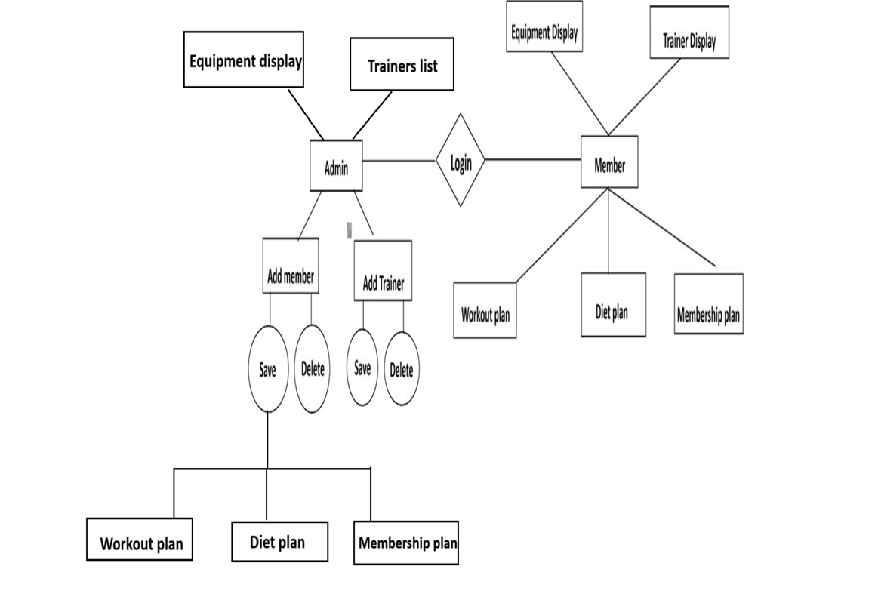
7. Block Diagram

Slide 10
Thank You...!!

